Slide 1
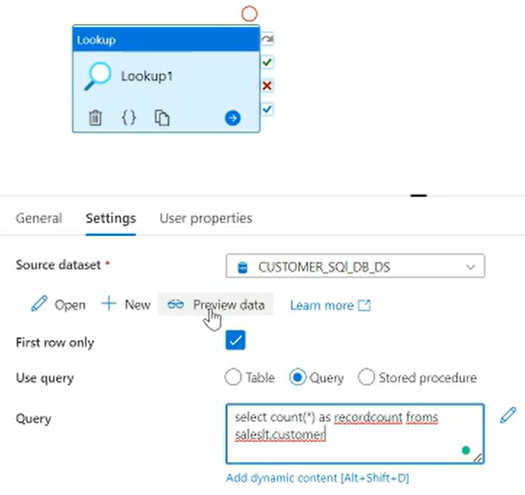
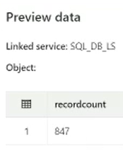
SELECT COUNT(*) AS RECORDCOUNT FROM sales.customer

Slide 2
